Slide 1





Derechos:
An introduction
Stephen F. Corfidi
OU / CIWRO
Cooperative Institute for Severe and High-Impact
Weather Research and Operations
and NOAA / NWS / NCEP Storm Prediction Center
9 February 2024
Notes:
Hello. Welcome to WDTD’s introductory module on derechos.

Slide 2
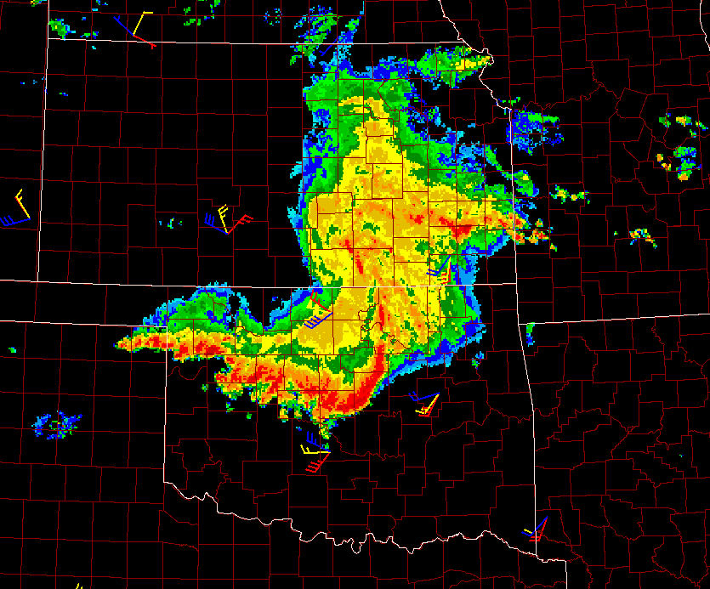
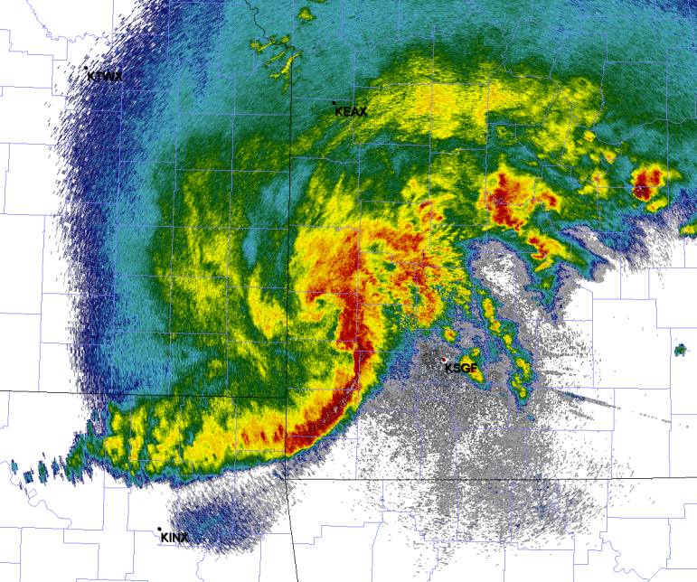
Presentation overview
What is a derecho?
Climatology
Primary types of derechos
Formation and movement of derecho-producing convective systems
Flash flooding and embedded circulations with derechos
Summary
MCV
Heavy rain
High wind
“Concurrent” MCS
MCS with an MCV
Notes:
This presentation introduces what a derecho is and presents a brief climatology of derecho occurrence in the United States. The primary types of derecho-producing convective systems, and their formation and motion, also will be covered. The module discusses the risk for heavy rainfall with derecho-producing convective systems, and illustrates the small-scale circulations that accompany some systems. A summary completes the presentation.

Slide 3
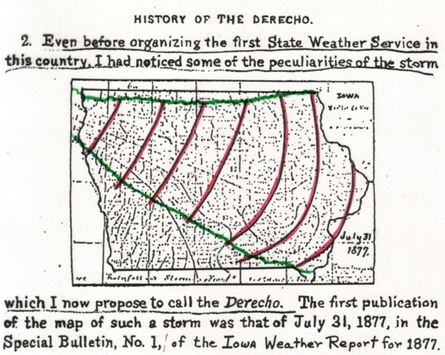
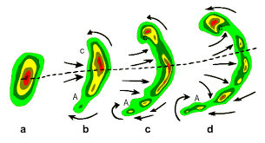
What is a Derecho?
A widespread, long-lived windstorm associated with a band of rapidly-moving
showers or thunderstorms
Term coined by Gustavus Hinrichs, Iowa State Climatologist, in 1888
“Derecho,” a Spanish word meaning "direct" or "straight ahead,”
chosen to reflect their relatively straight damage swaths
Greatest damage associated with embedded downbursts --- concentrated,
convectively-induced downdrafts
Downbursts typically occur in clusters produced by arc-shaped bands of storms called bow echoes
Bow echoes often contain a pair of embedded circulations known as book-end vortices; the strongest and most sustained winds typically occur with rear-inflow jets that arise between such vortices
Book-end vortex
Temporal evolution
(approx. 1-hour, left to right)
of a typical bow echo, as seen
via radar reflectivity
Rear-inflow jet
Book-end vortex
Left: After COMET
Notes:
So what is a derecho? A derecho is a widespread, long-lived windstorm associated with a band of rapidly-moving showers or thunderstorms. The term was first coined by Iowa State Climatologist Dr Gustavus Hinrichs in 1888. “Derecho,” a Spanish word meaning "direct" or "straight ahead,” was chosen by Hinrichs to reflect the relatively straight-line damage swaths of these storms. Downbursts --- concentrated, convectively-induced downdrafts --- are responsible for most derecho damage. Downbursts typically occur in clusters that are produced by arc-shaped bands of thunderstorms known as bow echoes. Bow echoes often contain a pair of embedded circulations known as book-end vortices; the strongest and most sustained winds typically occur with rear-inflow jets that arise between the centers of such vortices.

Slide 4
Official (AMS) definition
The “official” (AMS) derecho definition includes both size
and meteorological criteria:
A widespread, convectively induced straight-line windstorm; specifically, a family of particularly damaging downbursts produced by a mesoscale convective system (MCS)
Derecho-producing MCSs have sustained bow echoes, with book-end vortices and/or rear-inflow jets that produce damaging straight-line (i.e., non-tornadic) winds
Damage occurs continuously or intermittently over a swath at least 650 km (~400 miles) long and 100 km (~60 km) wide
Persistence!!!
100 km (60 mi)
650 km (400 mi)
Notes:
The “official” (AMS) definition of a derecho includes both size and meteorological criteria:
A widespread, convectively induced straight-line windstorm; specifically, a family of particularly damaging downbursts produced by a mesoscale convective system (MCS)
Derecho-producing MCSs have sustained bow echoes, with book-end vortices and/or rear-inflow jets that produce damaging straight-line (i.e., non-tornadic) winds
Damage occurs continuously or intermittently over a swath at least 650 km (~400 mi) long and 100 km (~60 mi) wide
While not specifically mentioned in the current AMS definition, an important characteristic of derecho storms is the prolonged nature of the damaging winds; while high winds often accompany the associated convective system’s gust front, a key characteristic of derechos is the onset or persistence of high winds tens of minutes to sometimes an hour after the system gust front has passed

Slide 5
Notable recent derechos
6 June 2020: Colorado / Wyoming to North Dakota
Formed in eastern Utah, crossed the Continental Divide, then continued northeast to the Dakotas
Wind gusts ~100 kts along 750-mile path length
Occurred in relatively dry environment
10 August 2020: Eastern Nebraska to northern Illinois
$11+ billion damage, most costly thunderstorm event in U.S. history; 4 fatalities
Recorded wind gusts to 110 kts; estimates as high as 120 kts
High winds persisted up to an hour (vs. usual 10-20 minutes); storm moved with a forward speed of 50 kts
45% of Iowa’s crops affected, especially over the eastern part of the state
Near-complete electrical outage in Cedar Rapids, Iowa; outage lasted for weeks in some parts of the city
15 December 2021: Eastern Nebraska to southwest Wisconsin
Accompanied an intense extratropical cyclone that also produced a dust storm and numerous tornadoes
Most prolific wind-producing thunderstorm system in December on record
100-kt gusts; damage swath more than 600 miles long; 2 fatalities
21 May 2022: Southern Ontario / Western Quebec
$875 million damage; 12 fatalities
Sixth-largest insurance loss event in Canada
100-kt gusts; damage swath more than 600 miles long
Notes:
Here is a short list of notable derechos that have affected the United States and southern Canada in recent years; the widespread and significant impacts produced by these events speak for themselves.

Slide 6
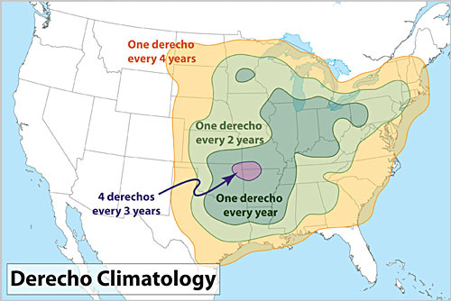
Derecho climatology in the United States
Primarily warm-season, May- August, although serial derechos may occur at any time of the year
Two corridors of maximum frequency:
1) Upper Mississippi Valley to Ohio Valley
2) Southern Plains / Ozarks
After Coniglio and Stensrud (2004)
Notes:
Derechos most commonly occur in the mid-latitudes. Their frequency can vary from place-to-place and from year-to-year depending on the prevailing, synoptic-scale weather patterns that bring together the meteorological ingredients necessary for their development. In the United States, the most significant events occur during the warmer months, although they occasionally occur at other times of the year. Two main corridors of enhanced frequency may be noted: From the Upper Mississippi Valley to the Ohio Valley / Mid-Atlantic states, and from the Southern Plains into the Ozarks. Derechos do sometimes affect interior portions of the western states, but generally average less than one per year. It is worth noting that the incidence map shown was derived from United States storm reports; as a result, indicated frequency may be artificially low near the Canadian border and along the Gulf and Atlantic coasts.

Slide 7
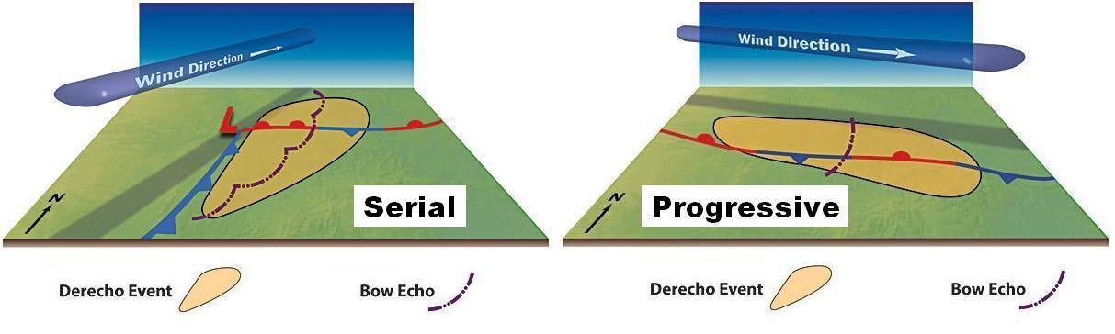




Two main classes of derechos:
Progressive and Serial
…Based on the primary physical processes responsible for their development
(A) Progressive
Associated with expansive regions of very moist, unstable air
Typically evolve from a single bow echo or storm cluster that grows into a forward-propagating MCS as new cell development occurs rapidly and sequentially down-shear
Derecho-producing MCS is oriented perpendicular to the upper-level wind, and moves faster than the mean flow
Primarily warm-season (late spring through summer)
At some locations, high winds can persist for up to an hour after system gust front has passed
Derecho event
MCS
Adapted from illustration by Dennis Cain
Notes:
Two main classes of derechos are generally recognized: Progressive and Serial; these two categories are based on the primary physical processes responsible for their development. Progressive derechos are associated with expansive regions of very moist, unstable air and typically evolve from a single bow echo or storm cluster that grows into a forward-propagating MCS as new cell development occurs rapidly and sequentially in the down-shear direction. The associated derecho-producing MCS is oriented perpendicular to the upper-level wind, and moves faster than the mean flow. Progressive derechos are primarily warm-season, occurring from late spring through summer. Progressive derechos can yield high winds that sometimes persist for up to an hour after the system gust front has passed.

Slide 8
Two main classes of derechos:
Progressive and Serial
…Based on the primary physical processes responsible for their development
(B) Serial
Associated with strong, fast-moving upper-level troughs and surface lows
Consist of a series of bow echoes embedded within an extensive squall line along or ahead of cold front, with the bows moving roughly parallel to the cloud-layer flow
Derecho-producing MCS moves with or more slowly than mean cloud-layer flow
Primarily cool-season (fall, winter, and spring)
Derecho event
MCS
Adapted from illustration by Dennis Cain
Notes:
Serial derechos are associated with strong, fast-moving upper-level troughs and surface low pressure systems. Serial derechos consist of a series of bow echoes that are embedded within an extensive squall line along or ahead of cold front. The bow echoes typically move roughly parallel to the cloud-layer flow, and tend to move more slowly than that flow. Serial derechos are primarily a cool-season phenomena, and on occasion affect swathes 1000 miles long.

Slide 9
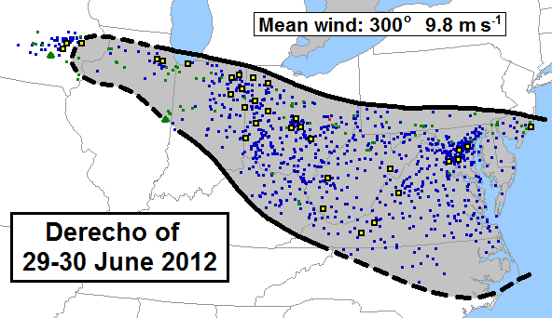
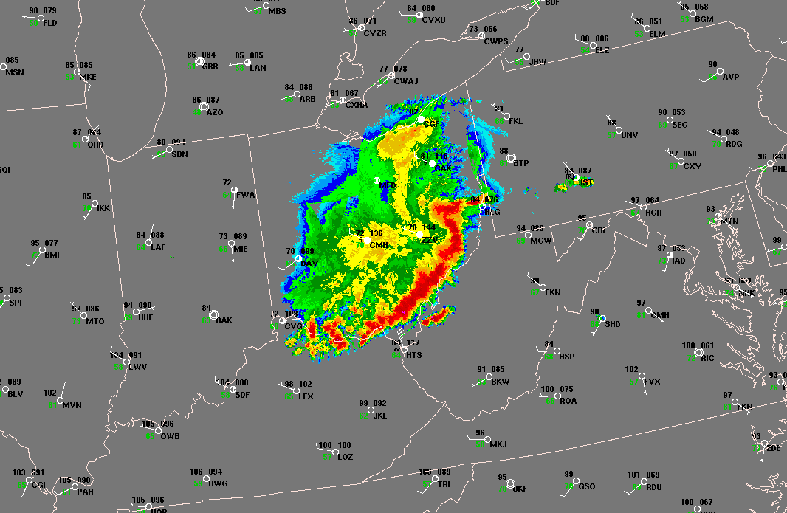
Example progressive derecho
29-30 June 2012, northern Illinois to the mid-Atlantic states
Storm reports (wind damage, blue squares; measured or estimated wind gusts greater than 65 kts, yellow squares; hail, green triangles)
500-mb analysis, 1200 UTC 29 June 2012
Derecho-producing MCS formed in west-northwesterly mid-level flow on the northern fringe of a strong sub-tropical ridge
A bow echo over northern Illinois evolved into an intense squall line as new cell development along the bow’s outflow boundary occurred rapidly, preferentially, and persistently in the downstream (down-shear) direction, parallel to the upper-level flow
The MCS moved with an average speed of 51 kts --- much faster than the 19-kt mean tropospheric flow
Composite reflectivity, 2234 UTC 29 June 2012
Corfidi et al. (2016)
Notes:
Here is an example of a newsworthy progressive-type derecho that affected the Midwestern and eastern United States in June 2012. The derecho-producing MCS formed in west-northwesterly mid-level flow over eastern Iowa and northern Illinois on the northern fringe of a strong, sub-tropical ridge. The initial thunderstorms over Illinois --- some of which were elevated (that is, they formed atop a frontal surface, within a layer of buoyancy aloft) --- quickly evolved into a surface-based bow echo. The bow echo subsequently grew into an intense, forward-propagating squall line that accelerated east-southeast across Indiana, Ohio, and West Virginia to the mid-Atlantic coast. “Forward-propagating” indicates that new cell development occurred preferentially along the most rapidly-moving part of the bow echo’s accelerating outflow boundary --- that is, new storm development occurred rapidly and sequentially in the downstream (downshear) direction, parallel to the west-northwesterly flow aloft. The rapid development of intense convective updrafts along the leading edge of the gust front essentially allowed the derecho-producing convective system to regenerate itself in the downshear direction --- until the MCS ultimately out-ran the reservoir of strong surface-based instability that extended as far east as the Atlantic coast. The derecho-producing MCS moved with an average speed of 51 kts --- much faster than the 19-kt mean tropospheric flow.

Slide 10
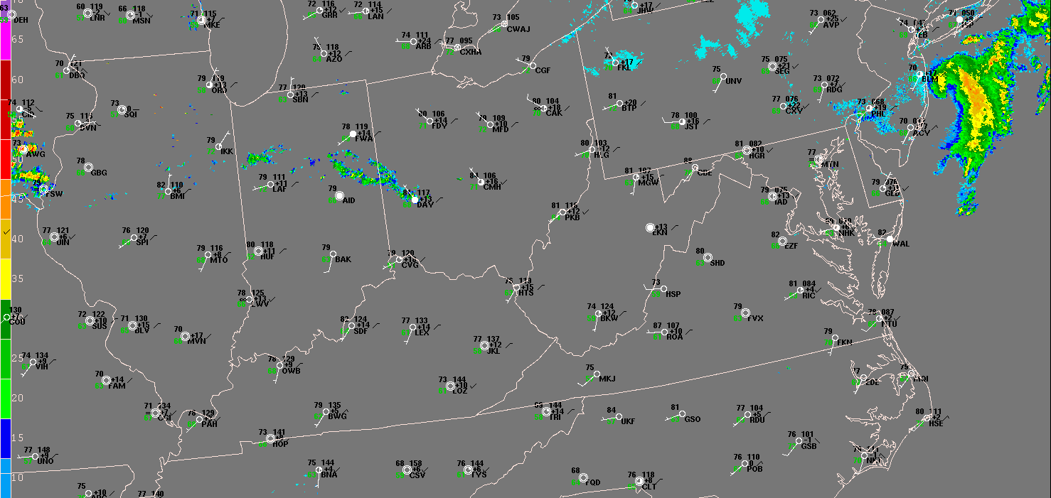
Example progressive derecho
29-30 June 2012, northern Illinois to the mid-Atlantic states
18-hr composite reflectivity loop, 1215 UTC 29 June – 0640 UTC 30 June
Notes:
This 18-hour, mosaiced animation of composite radar reflectivity from the June 2012 progressive-type event shows the evolution of the derecho from elevated thunderstorms in eastern Iowa and Illinois to an accelerating, forward-propagating convective system over the Midwest and East. Note the very warm and moist conditions present along and south of the derecho’s path. The very warm and moist air helped boost surface-based buoyancy, especially during the period of maximum afternoon heating over the Ohio Valley and central Appalachians.

Slide 11
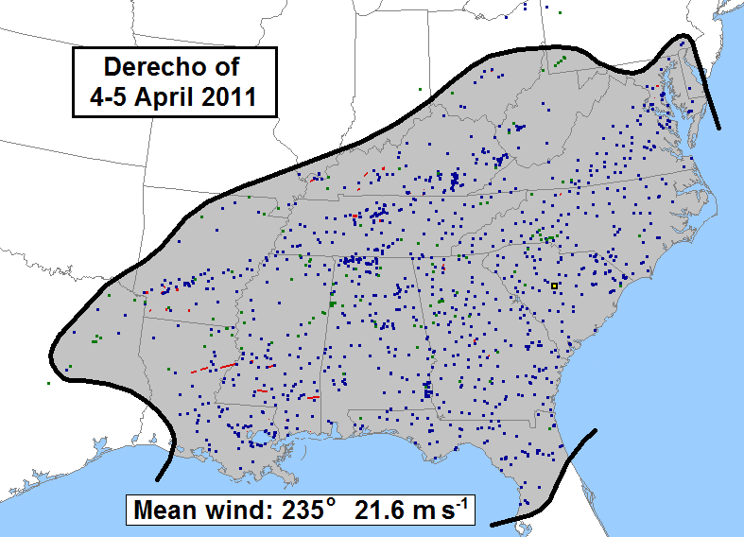
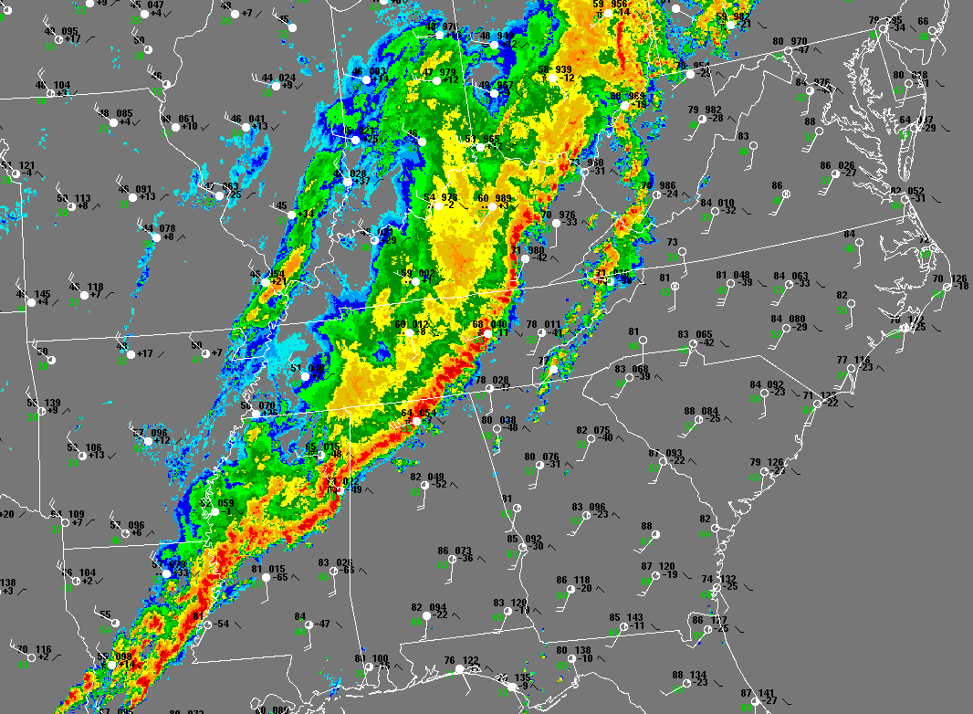
Example serial derecho
4-5 April 2011, Mississippi Valley to the East Coast
500-mb analysis, 1200 UTC 4 April 2011; shortwave trough marked by heavy black line
Storm reports (wind damage, blue squares; measured or estimated wind gusts greater than 65 kts, yellow squares; hail, green triangles; tornadoes, red squares)
Derecho-producing MCS formed in southwesterly mid-level flow ahead of a strong, migratory short-wave trough
Extensive squall line (QLCS), more than 600 miles long and oriented roughly parallel to the upper-level flow, swept eastward ahead of associated cold front
MCS moved more slowly than the mean wind (34 kts vs. 42 kts, respectively), despite presence of multiple, embedded bow echoes
Composite reflectivity, 2056 UTC 4 April 2011
Notes:
A classic serial-type derecho affected a broad swath of the central and eastern United States in early April 2011. The associated MCS formed in southwesterly mid-level flow ahead of a strong, migratory short-wave trough seen at 500 mb in the upper-right panel. An extensive squall line (QLCS) --- more than 600 miles long and oriented roughly parallel to the upper-level flow --- swept east from the lower Mississippi Valley to the East Coast, ahead of the surface cold front attendant to the upper trough. The QLCS advanced eastward more slowly than the mean wind (34 kts vs. 42 kts, respectively), despite presence of multiple, embedded bow echoes that moved mainly northeastward with the mean cloud-layer flow.

Slide 12
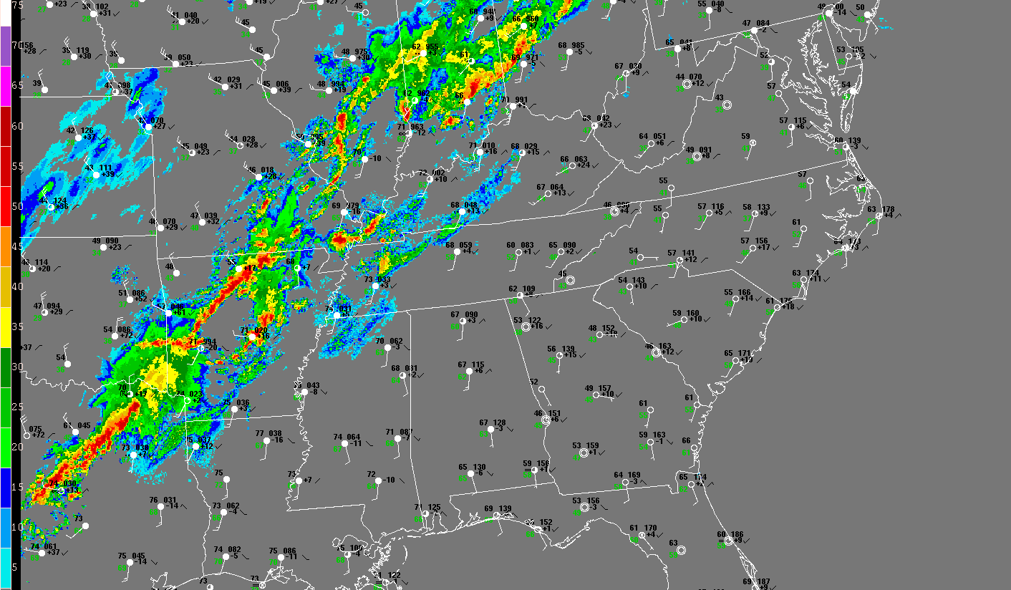
Example serial derecho
4-5 April 2011, Mississippi Valley to the East Coast
24-hr composite reflectivity loop, 1200 UTC 4 April – 1200 UTC 5 April
(Loop pauses to show line-echo wave-patterns ---“LEWPs” --- associated with embedded bow echoes)
Notes:
This 24-hour, mosaiced animation of composite radar reflectivity from the April 2011 serial-type derecho shows the movement of the associated squall line from the lower Mississippi Valley and Ozarks on the morning of April 4th to its arrival along the south and mid-Atlantic coast on the morning of the 5th. The loop twice pauses to highlight the presence of “LEWPs” --- the acronym for “line-echo wave-patterns.” LEWPs are wave-shaped inflections that appear in radar depictions of squall lines, reflecting the presence of bow echoes in the line.

Slide 13
Two other classes of derechos
Hybrid derechos
Share characteristics of both progressive and serial types
Most often occur in late spring and early summer, when the background environment can exhibit expansive areas of rich low-level moisture and strong buoyancy with appreciable deep shear
May include semi-discrete supercells that pose significant tornado, large hail, and heavy rainfall threats in addition to damaging wind
Low-dewpoint derechos
Uncommon; occur in regions with relatively limited boundary-layer moisture (e.g., surface dewpoints in the 40s or low 50s F), but steep low- to mid-level lapse rates
Associated with strong short-wave troughs; they are essentially moisture-starved serial derechos
Most often occur in the Great Basin and Rockies in late spring and early summer, when surface heating strongly destabilizes the low-level environment in the presence of appreciable deep shear --- fostering organized bands of downstream-directed dry downbursts
Low-dewpoint derechos also occur during the cool season over the central and eastern U.S., in association with strong, migratory shortwave-troughs having seasonably warm and broad warm sectors
Notes:
Two other classes of derechos may be distinguished: Hybrid derechos and low-dewpoint derechos. Hybrid derechos share characteristics of both progressive- and serial-type derechos. They most often occur in late spring and early summer, when the background environment can exhibit expansive areas of rich low-level moisture and strong buoyancy in the presence of appreciable deep shear. Hybrid derechos may include semi-discrete supercells that pose significant tornado, large hail, and heavy rainfall threats --- in addition to damaging wind.
Low-dewpoint derechos are uncommon. They occur in regions having relatively limited boundary-layer moisture (e.g., surface dewpoints in the 40s or low 50s F), but steep low- to mid-level lapse rates. Low-dewpoint derechos typically are associated with strong short-wave troughs and are essentially moisture-starved, serial-type derechos. Low-dewpoint derechos most often occur in the Great Basin and Rockies in late spring and early summer, when surface heating strongly destabilizes the low-level environment in the presence of appreciable deep shear --- fostering organized bands of downstream-directed dry downbursts. Low-dewpoint derechos also may occur during the cool season over the central and eastern U.S., in association with strong, migratory shortwave-troughs having seasonably warm and broad warm sectors.

Slide 14
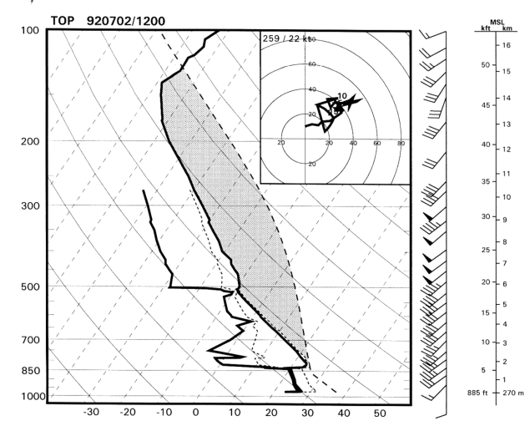
Characteristic environmental conditions
An expansive (meso-alpha scale; 200-2000 km) warm sector region having:
Seasonably rich low-level moisture
1) Surface dewpoints > 70 F (Progressive)
2) Surface dewpoints > 65 F (Serial)
Steep low-level and mid-level lapse rates --- the latter typically associated with an elevated mixed layer (EML; the EML inhibits / limits extent of deep-convective development)
Seasonably strong, unidirectional surface to 500-mb shear:
1) > 30 kts (Progressive)
2) > 50 kts (Serial)
3) Faster flow above 500 mb enhances potential
Sustained focus for ascent:
1) Weak stationary front oriented parallel to upper-level flow,
a lee-surface trough, or weak, lower-tropospheric, warm-air advection (Progressive)
2) Strong cold front and associated surface trough (Serial)
Sample derecho
thermodynamic and
wind profiles
Notes:
So what are the primary meteorological characteristics of derecho-producing environments? Basically, an expansive (meso-alpha scale; 200-2000 km) warm sector region having:
(A) Seasonably rich low-level moisture
1) Surface dewpoints > 70 F (Progressive)
2) Surface dewpoints > 65 F (Serial)
(B) Steep low-level and mid-level lapse rates --- the latter typically associated with an elevated mixed layer (EML; the EML inhibits / limits extent of deep-convective development)
(C) Seasonably strong, unidirectional surface to 500-mb shear:
1) > 30 kts (Progressive)
2) > 50 kts (Serial)
3) Faster flow above 500 mb enhances potential
(D) A sustained (but sometimes subtle) focus for ascent:
1) Weak stationary front oriented parallel to upper-level flow, a lee-surface trough, or weak, lower-tropospheric, warm-air advection (Progressive)
2) Strong cold front and associated surface trough (Serial)

Slide 15
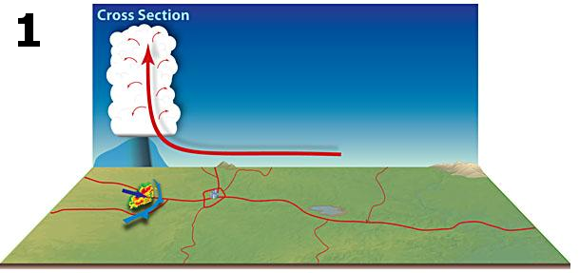
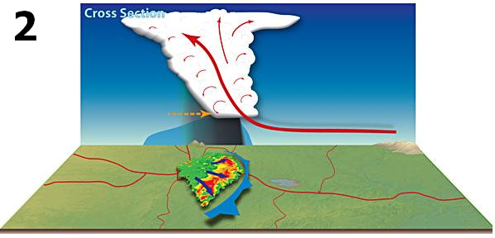
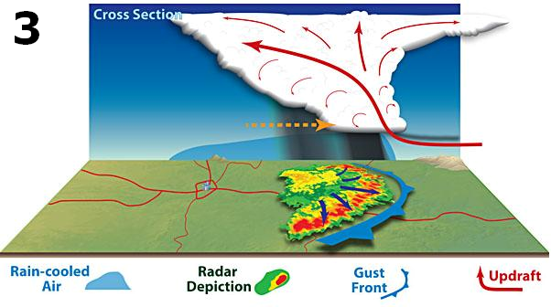
Derecho development
Initial storms form in region where strong, nearly unidirectional mid- to upper-tropospheric flow (here, assumed to be westerly) overlies a broad area of high potential instability --- especially in an environment with rich low-level moisture and steep low- to mid-level lapse rates that together yield high CAPE
Uplift along the gust front --- the leading edge of evaporatively-cooled, low-level outflow from the initial storms --- sequentially spawns new storm development in the downstream direction as the cool-air dome preferentially elongates in direction of the mean flow; this is “forward propagation”
Rapid downstream development results in anvil cloud material being left behind in wake of progressive gust front, fostering formation of a rear-inflow jet that enhances rear-to-front flow at mid-levels into the back-side of the convective system; this flow, sometimes enhanced by the presence of paired, rotating storms on either end of embedded bows echoes, furthers the development of new storms along system gust front
New cell development --- and potential sustenance of derecho-strength winds --- is perpetuated as long as thermodynamic and kinematic fields remain favorable for deep convection in the downstream direction
Winds may be locally enhanced by the presence of embedded supercells and smaller-scale circulations
1
Initial cell development
in very moist, high-CAPE air
2
Downstream (forward) propagation along gust front
3
Anvil material lofted upstream
Rear-inflow jet
Adapted from illustration by Dennis Cain
Notes:
The development of a typical progressive-type derecho is depicted schematically in the accompanying illustrations. First, (1) the initial storms form in a region where strong, nearly unidirectional mid- to upper-tropospheric flow (here, assumed to be westerly) overlies a broad area of high potential instability --- especially in an environment with rich low-level moisture and steep low- to mid-level lapse rates that together yield high CAPE. (2) Uplift along the composite gust front from the initial storms --- the leading edge of evaporatively-cooled, low-level outflow from those storms --- sequentially spawns new storm development in the downstream direction as the associated cool-air dome preferentially elongates in direction of the mean flow, supporting rapid “forward propagation.” (3) Rapid, downstream-directed convective development results in anvil cloud material being left behind in wake of the progressive gust front, fostering formation of an evaporatively-induced rear-inflow jet that enhances rear-to-front mid-level flow into the back-side of the convective system; this flow, sometimes enhanced by the presence of paired, rotating storms on either end of embedded bows echoes, furthers the development of new storms along system gust front. (4) New cell development --- and potential sustenance of derecho-strength winds --- is perpetuated as long as thermodynamic and kinematic fields remain favorable for deep convection in the downstream direction. (5) Embedded supercells and any smaller-scale circulations can locally augment outflow winds and yield corridors of enhanced damage.

Slide 16
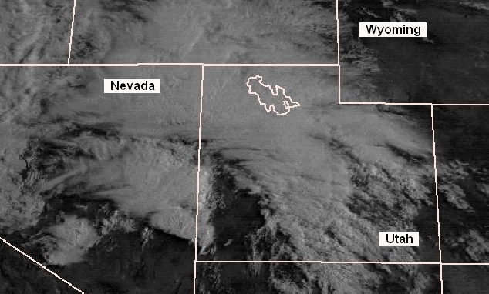
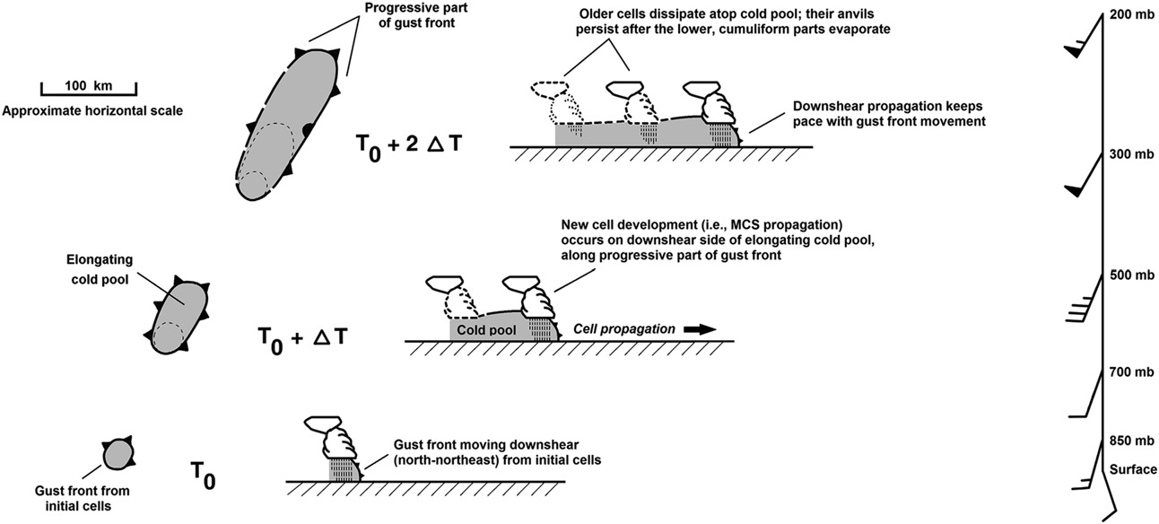
Satellite and schematic illustrations of derecho development
Visible-data, 8-hr satellite loop of a low-dew point derecho in Utah, showing anvil material left behind in the upstream (in this case, southwest) direction as a result of rapid forward (north-northeastward) propagation of storms on the gust front of the system’s elongating cold pool
Plan (left) and cross-sectional (center) schematics of the Utah derecho; the associated MCS formed in fast, nearly unidirectional south-southwesterly flow (shown by wind profile at far right); time increases from bottom to top in the schematics
Corfidi (2016)
Notes:
The visible-data satellite animation and accompanying schematic depict the forward-propagation process that is fundamental to derecho development. A low-dewpoint derecho that moved north-northeast across the Great Basin was selected for illustration because, due to the relatively dry environment involved, there was only minimal supplementary cloud cover of the type that typically obscures the forward propagation process in more moist regimes. As the arc-shaped gust front advances north-northeast across Utah, the rapidly-growing, new updrafts appear as sharply-outlined, whitish clumps (cumulus and cumulonimbus clouds) in the satellite loop. These active convective towers stand in marked contrast to the fibrous cirrus debris left behind as the gust front accelerates downstream, undercutting the older updrafts and severing their link to warm, buoyant surface air. The derecho-producing convective system is therefore seen to be composed of a series of discrete, downwind-developing, wind-producing thunderstorms.

Slide 17
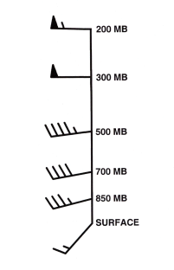
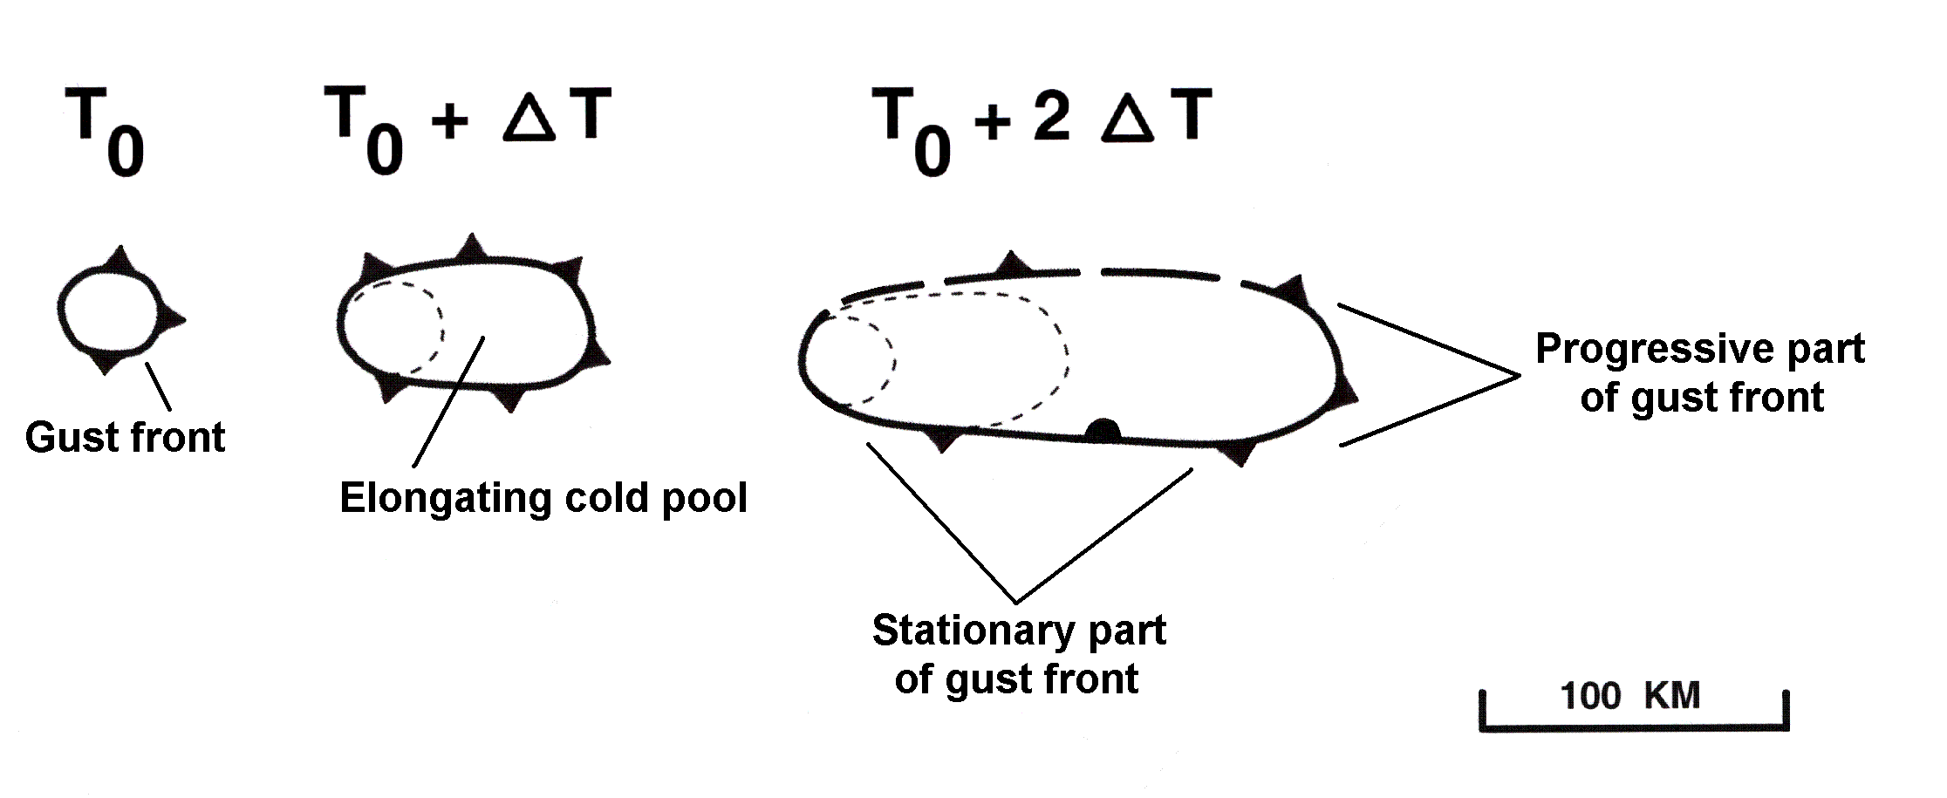
Derechos and flash floods
Paradoxically, the same unidirectional flow that fosters downstream storm propagation and derecho-producing MCS development can, given a supportive thermodynamic environment, also yield repetitive storm propagation in the upstream direction
Repetitive upstream storm development, especially when associated with a low-level source of uplift that remains quasi-stationary, can yield excessive precipitation if the environment is very moist and conditionally unstable
Because derecho-producing convective systems occur with largely unidirectional mid- and upper-level flow, their cold pools tend to elongate downstream in the direction of the mean flow
Consequently, over time, parts of the system gust fronts often become quasi-stationary, oriented roughly parallel to the deep tropospheric flow (highlighted in green in schematic below)
Those parts of a derecho-producing convective-system gust front that become quasi-stationary can be a focus for “echo-training” and flash flooding --- sometimes in locations recently affected by derecho winds
Progressive part
of gust front
(derecho / high wind)
Stationary part of gust front (possible focus for flash flooding)
Temporal evolution of elongating cold pool associated with wind profile at left
Notes:
Derecho-producing MCSs sometimes also produce excessive rainfall. This follows because the same unidirectional flow that fosters downstream storm propagation and derecho-producing MCS development can, given a supportive thermodynamic environment, also yield repetitive storm propagation in the upstream direction. Repetitive upstream storm development, especially when associated with a low-level source of uplift that remains quasi-stationary, can yield flash flooding if the environment is very moist and conditionally unstable. Because derecho-producing convective systems occur with largely unidirectional mid- and upper-level flow, their cold pools tend to elongate downstream in the direction of the mean flow --- i.e., in the downstream direction. Consequently, over time, parts of the system gust fronts often become quasi-stationary, oriented roughly parallel to the deep tropospheric flow --- as highlighted in green in the schematic. Those parts of a derecho-producing convective-system gust front that become quasi-stationary can be a focus for “echo-training” and flash flooding --- sometimes in locations recently affected by derecho winds --- thus, imparting a “double-whammy” impact.

Slide 18
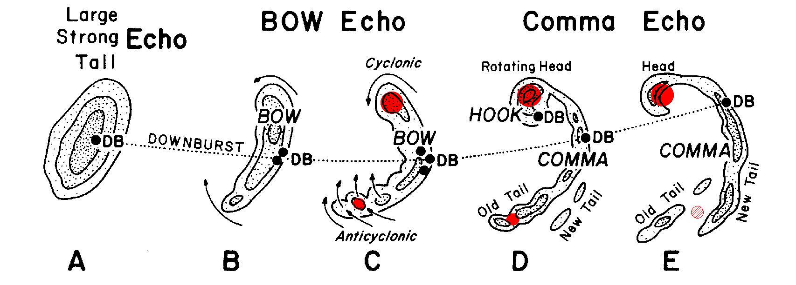
Embedded vortices - 1
Although storm downdrafts produce most non-tornadic derecho winds, observations and numerical simulations indicate that the most-prolonged extreme winds and the most significant damage are associated with embedded circulations known as mesovortices
Derecho mesovortices may appear in various sizes, ranging from meso-gamma (2-20 km) to meso-beta (20-200 km) and, occasionally, meso-alpha (200-2000 km) scale
Mesovortices arise in many ways. For example, the development of a rear-inflow jet in a strengthening MCS can yield a pair of counter-rotating meso-gamma to small meso-beta scale book-end vortices (shown in red in the schematic below) astride the jet; dynamically-enhanced updrafts in these rotation centers can further strengthen the MCS
And, as previously noted, the enhanced rear-to-front flow between two book-end vortices can initiate or enhance a bowing structure already present in an MCS
Prototype of temporal evolution (A through E) of a bow echo; black contours depict radar reflectivity, and dotted line, path of strongest surface winds
After Fujita (1978)
Notes:
Embedded mesoscale circulations of various origins and sizes --- collectively known as mesovortices --- are an important component of most derechos. Although storm downdrafts are responsible for most non-tornadic derecho winds, observations and numerical simulations indicate that the corridors of most-prolonged extreme winds and the most significant damage are associated with embedded mesovortices. Derecho mesovortices may range in size from the meso-gamma (2-20 km) to the meso-beta (20-200 km) and, occasionally, meso-alpha (200-2000 km) scales. Mesovortices arise in many ways. For example, the development of a rear-inflow jet in a strengthening MCS can yield a pair of counter-rotating meso-gamma to small meso-beta scale book-end vortices (shown in red in the schematic) astride the jet; dynamically-enhanced updrafts in these rotation centers can further strengthen the MCS. Also, as previously noted, the enhanced rear-to-front flow between two book-end vortices can initiate or enhance a bowing structure already present in an MCS.

Slide 19
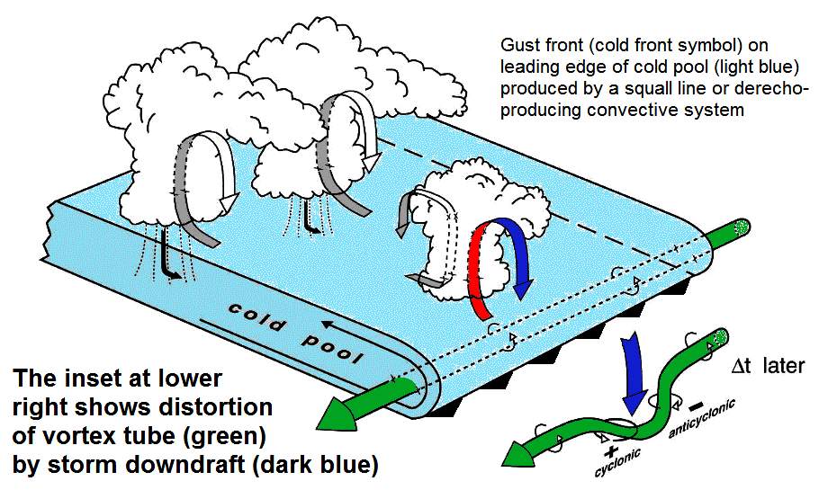
Embedded vortices - 2
Pairs of counter-rotating vortices also may arise from the downward bending of horizontal vorticity by storm downdrafts, as shown in schematic below
In the schematic, the horizontal vortex tube along the MCS gust front is shown in green; the distortion of the tube after its downward bending by a downdraft (blue arrow) is shown at lower right
Stretching of the paired cyclonic / anticyclonic vertical circulations --- for example, by the chance super-positioning of an updraft above one of the vortex pairs --- can yield short-lived, tornado-strength circulations on derecho gust fronts
After Wakimoto (2006)
Notes:
A pair of counter-rotating mesovortices also may arise from the downward bending of horizontal vorticity by storm downdrafts, as shown in the schematic adapted from Wakimoto 2006. In the schematic, the horizontal vortex tube that arises as a result of cross-boundary differential buoyancy along the MCS gust front is shown in green; the distortion of the tube after its downward bending by a downdraft (blue arrow) is shown at the lower right. Stretching of the paired cyclonic / anticyclonic vertical circulations that arise as a result of this distortion --- for example, by the chance super-positioning of an updraft above one of the vortex pairs --- can yield short-lived, tornado-strength circulations on derecho gust fronts.

Slide 20
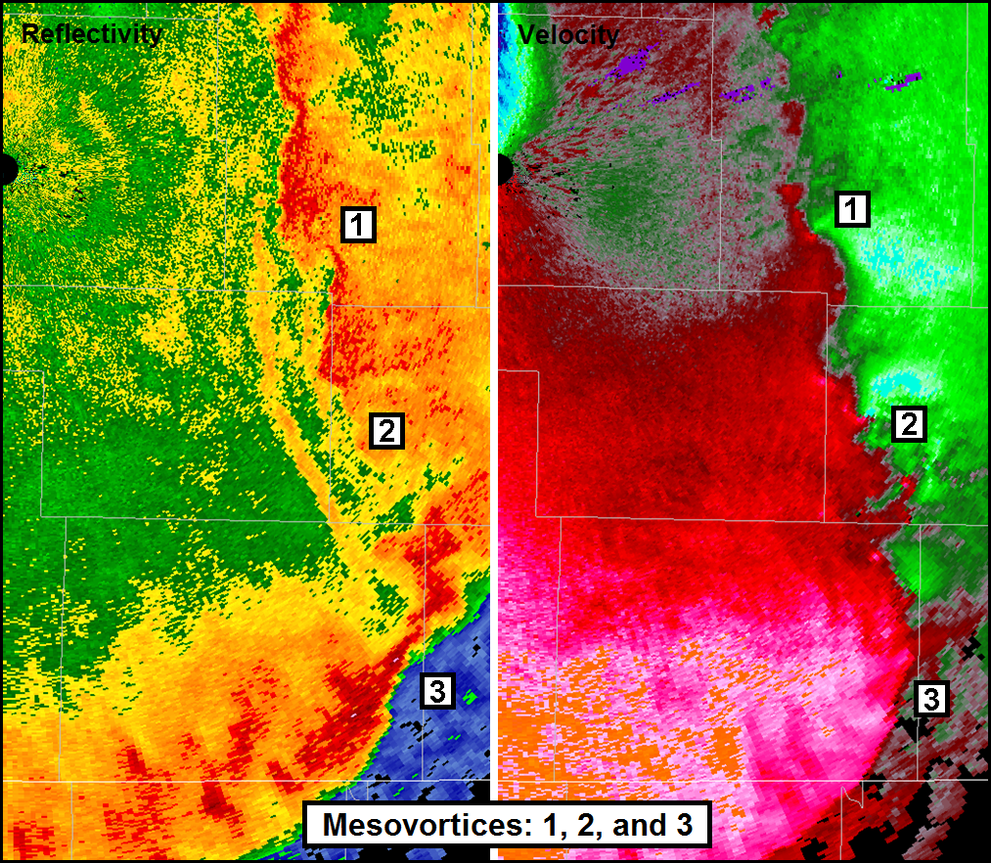
Embedded vortices - 3
Smaller circulations on the order of a mile or two in diameter sometimes form along derecho gust fronts as a result of horizontal-shear instability
Shear instability arises from the presence of sharp changes in wind direction and/or speed that can exist across such boundaries
When the background wind shear and/or buoyancy are great, shear-induced vortices may sufficiently strengthen to produce tornado-like damage
Meso-circulations in some derecho-producing MCSs may be traced to supercell storms that were present during the early stages of the system’s development and were subsequently absorbed by it
Reflectivity
Velocity
Radar depiction of mesovortices in a strong derecho (9 May 2009, Southwest Missouri)
Vortices 1 and 2 are small-scale circulations that may have arisen due to the presence of strong horizontal shear along the gust front. Vortex 3 is larger, but broader. Animated reflectivity data suggest that this feature most likely was the residual circulation associated with a supercell storm overtaken by the convective system
Notes:
Smaller circulations on the order of a mile or two in diameter sometimes form along derecho gust fronts as a result horizontal-shear instability. Shear instability arises from the presence of sharp changes in wind direction and/or speed that can exist across such boundaries. When the background wind shear and/or buoyancy are great, shear-induced vortices may sufficiently strengthen to produce tornado-like damage within a larger-scale derecho-producing MCS. Meso-circulations in some derecho-producing MCSs also may be traced to supercell storms that were present during the early stages of the system’s development and were subsequently absorbed by it. The dual radar reflectivity and velocity images here show some of the various forms of mesovortices commonly encountered in derecho-producing MCSs.

Slide 21
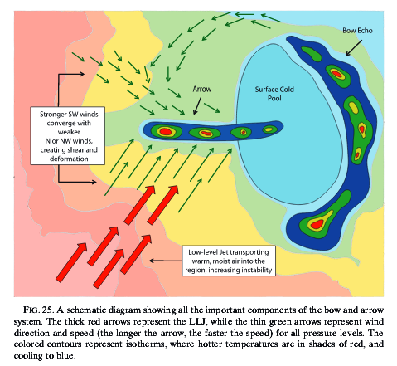
Embedded vortices - 4
Larger-scale mesovortices, known as mesoscale convective vortices or MCVs, can arise from particularly large and long-lasting derecho-producing convective systems
MCVs are mid-level, meso-beta and meso-alpha scale cyclonic circulations that form as a result of concentrated latent heat release in the MCS core; they can persist for more than a day
MCVs can assist in the development of elevated (i.e., based above the boundary layer) bands of thunderstorms in the wake of a derecho-producing MCSs, as depicted in schematic below
As with the back-building / echo-training storms that often appear along the quasi-stationary parts of elongating, derecho-produced gust fronts, elevated, MCV-induced convective bands can produce excessive rain and hail in areas recently affected by derecho winds
Schematic of a “concurrent” (high wind and heavy rain-producing) MCS
Elevated, confluent flow associated with circulation in wake of high-wind producing MCS / bow echo can give rise to a persistent band of elevated storms that may produce heavy rain and hail in region recently affected by high winds
Keene and Schumacher (2013)
Notes:
Larger-scale mesovortices, known as mesoscale convective vortices or MCVs, sometimes form within particularly large and long-lasting derecho-producing convective systems. MCVs are mid-level, meso-beta and meso-alpha scale cyclonic circulations that form as a result of concentrated latent heat release in the MCS core; they can persist for more than a day. MCVs can assist in the development of elevated (i.e., based above the boundary layer) bands of thunderstorms in the wake of a derecho-producing MCSs, as depicted in schematic from Keene and Schumacher 2013. As with the back-building / echo-training storms that often appear along the quasi-stationary parts of elongating, derecho-produced gust fronts, elevated, MCV-induced convective bands can produce excessive rain and hail in areas recently affected by derecho winds.

Slide 22
Derecho forecasting
Derechos are difficult to forecast because their development depends on storm-scale processes that are not well resolved in the observational or model fields
Nevertheless, forecast confidence can be increased when the following appear in the Day-1 to Day-3 data:
1) A wide, seasonably warm and very moist “capped” warm sector lying beneath relatively fast, largely unidirectional mid- to upper-level flow
2) A source of sustained ascent, such as an area of locally-enhanced low-level warm-air advection and / or upper-level divergence, to initiate the first storms in a relatively confined (meso-beta scale) region
3) Modest but persistent down-shear directed lifting (often due to the same weak, localized warm-air advection that helped initiate the first storms) to foster downstream convective development
4) Favorably-timed onset of daytime heating / low-level destabilization in region downstream from area of initialization
5) The greatest threat for high winds will focus on the downwind edge of the expected elongating cold pool --- i.e., in the down-shear direction; any flash flood threat most likely will occur on the equatorward side of the elongating cold pool, after the upscale development of the derecho-producing MCS
Notes:
Derechos are difficult to forecast because their development depends on storm-scale processes that are not well resolved in observational and model fields. Nevertheless, forecast confidence can be increased when the following appear in the Day-1 to Day-3 data:
(1) A wide, seasonably warm and very moist “capped” warm sector lying beneath relatively fast, largely unidirectional mid- to upper-level flow
(2) A form of sustained synoptic- or mesoscale ascent, such as an area of locally-enhanced low-level warm-air advection and / or upper-level divergence, to initiate the first storms in a relatively confined (meso-beta scale) region
(3) Modest but persistent downstream–directed lifting (often due to the same weak, localized warm-air advection that helped initiate the first storms) to foster downstream convective development
(4) Favorably-timed onset of daytime heating / low-level destabilization in region downstream from area of storm initialization
(5) The greatest threat for high winds will focus on the downwind edge of the expected elongating cold pool --- i.e., in the downstream / downshear direction; any flash flood threat most likely will occur on the equatorward side of the elongating cold pool, after the upscale development of the derecho-producing MCS

Slide 23
Summary
A derecho is a widespread, long-lived, convectively induced straight-line windstorm --- or more specifically, a family of damaging downbursts produced by a fast-moving mesoscale convective system (MCS) having a path at least 650 km (400 miles) long and 100 km (60 miles) wide
Progressive, Serial, Hybrid, and Low-dewpoint derechos:
1) Progressive derechos: Weak forcing for ascent; oriented perpendicular to mean wind and move faster than mean flow; primarily warm-season; high winds can persist for a considerable time after gust front has passed
2) Serial derechos: Strong forcing for ascent; oriented roughly parallel to mean wind, and generally move more slowly than mean flow; mainly cool- season (fall, winter, and spring), but sometimes occur in summer (hybrid derechos)
3) Low-dewpoint derechos: Strong forcing for ascent in the presence of fast, unidirectional mean flow and very steep low- to mid-level lapse rates but relatively limited moisture; can occur throughout the year
Derechos arise when thermodynamic and wind environments are favorable for rapid and persistent downstream storm development (forward propagation) of downburst- producing thunderstorms over a broad (meso-alpha scale) region
Given supportive thermodynamic conditions, the deep, largely unidirectional wind profiles that foster forward-propagation and derecho-producing MCSs are also favorable for repetitive, upstream storm development on the quasi-stationary parts of the elongating MCS cold pools; this can yield concurrent high-wind and flash-flooding threats
Notes:
Summarizing this presentation, A derecho is a widespread, long-lived convectively induced straight-line windstorm --- or more specifically, a family of damaging downbursts produced by a fast-moving mesoscale convective system (MCS) having a path at least 650 km (400 miles) long and 100 km (60 miles) wide. Several forms of derechos are recognized. Progressive derechos are associated with relatively weak forcing for ascent; their associated MCSs are oriented perpendicular to mean tropospheric flow and move faster than that flow. They are primarily warm-season, and the high winds produced can persist for a considerable time after gust front has passed. Serial derechos occur with strong forcing for ascent and their associated MCSs tend to orient parallel to mean wind. Serial derechos generally move more slowly than the mean flow; they are mainly cool-season (fall, winter, and spring), but sometimes occur in summer in the form of “hybrid” systems. Low-dewpoint derechos typically occur when strong forcing for ascent and fast, unidirectional mean flow with steep low- to mid-level lapse rates are present with relatively limited moisture; they can occur throughout the year.
Derechos arise when thermodynamic and wind environments are favorable for rapid and persistent downstream storm development (forward propagation) of downburst-producing thunderstorms over a broad (meso-alpha scale) region. Given supportive thermodynamic conditions, the deep, largely unidirectional wind profiles that foster forward-propagation and derecho-producing MCSs are also favorable for repetitive, upstream storm development on the quasi-stationary parts of the elongating MCS cold pools; this can yield concurrent high-wind and flash-flooding threats.

